Slide 1
Trust Group Restructuring App

Slide 2
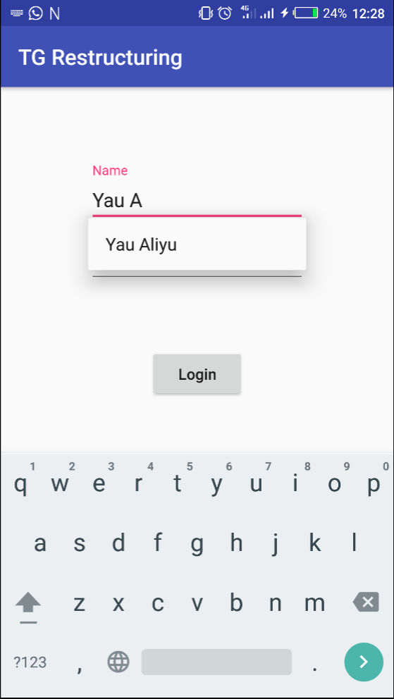
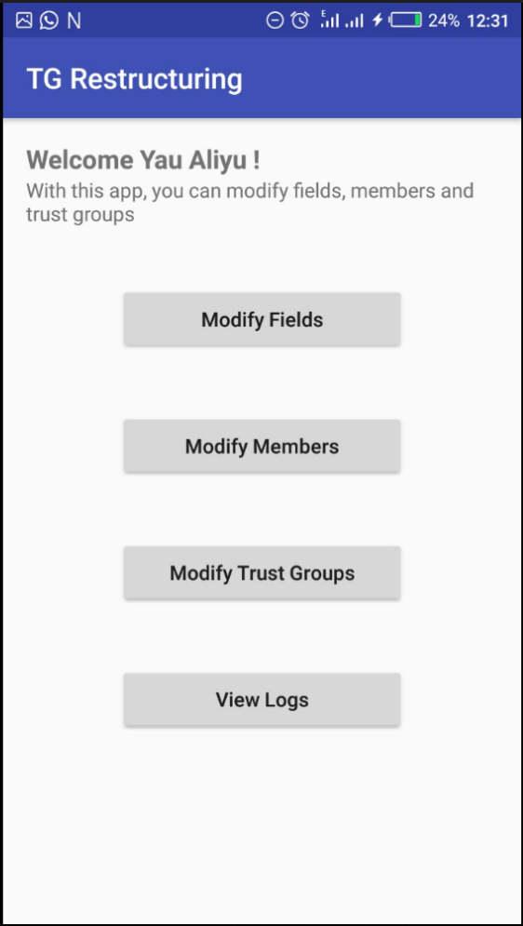
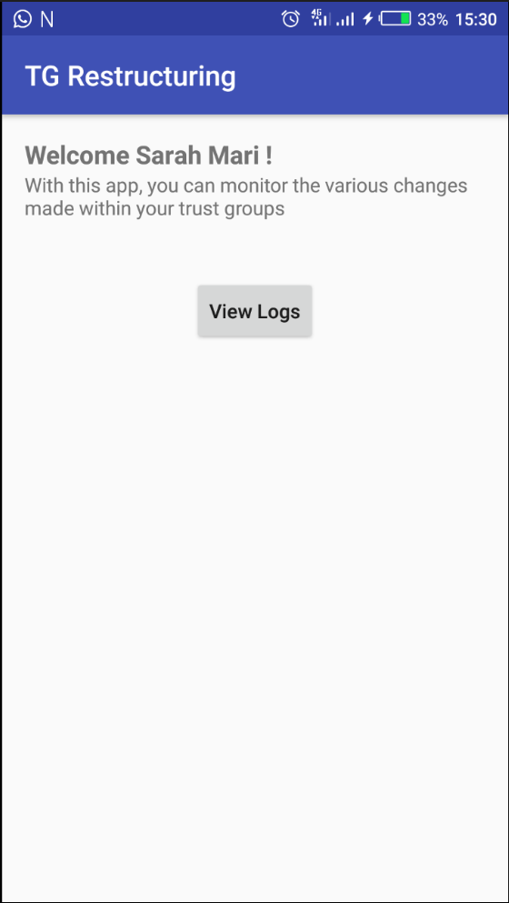
TG Restructuring App
When you start the app, the login page(1) opens which takes you to the MIK welcome page(2) or the ES welcome page(3)
1
2
3

Slide 3
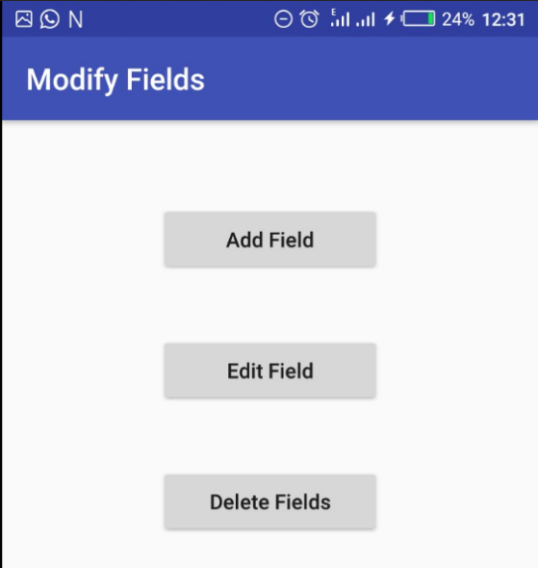
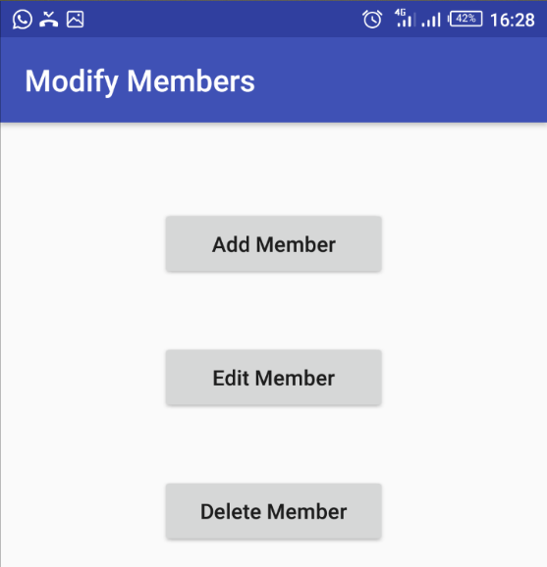
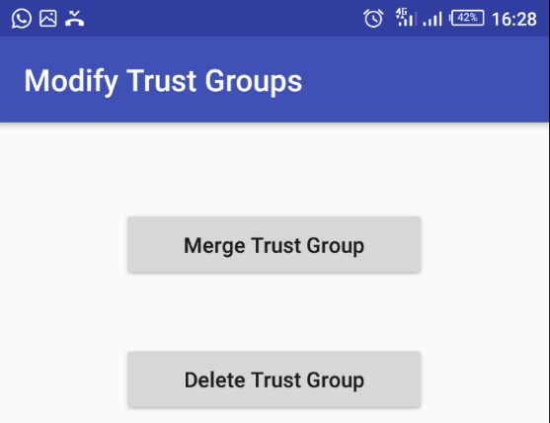
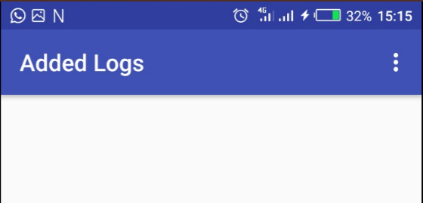
TG Restructuring App
MIK side

Slide 4
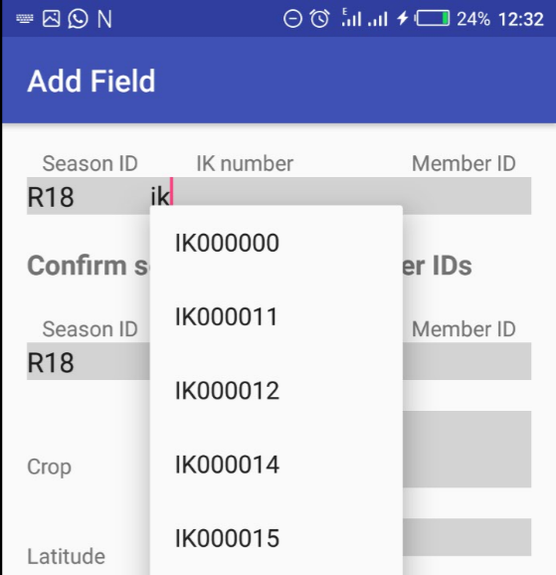
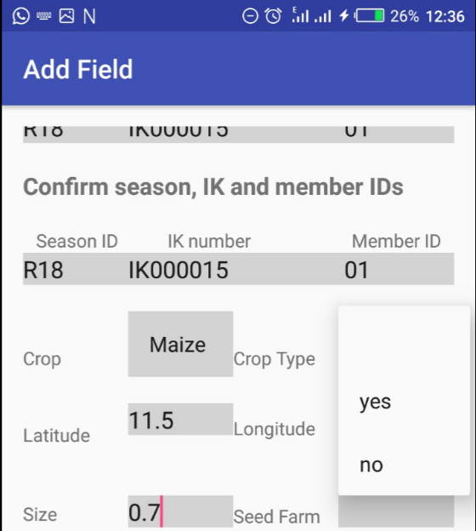
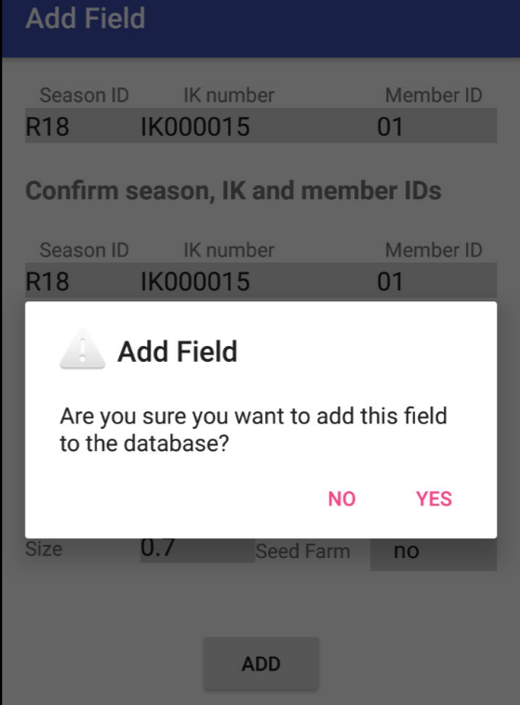
TG Restructuring App
Adding fields
The grey areas indicate the editable areas of the app.
The app is designed with an autocomplete feature that suggests IDs as you type them in
You need to select crop before selecting crop type
When all input fields have been filled, clicking on the add button will pop up a prompt to make sure you are sure of your action. Clicking yes saves this action locally.

Slide 5
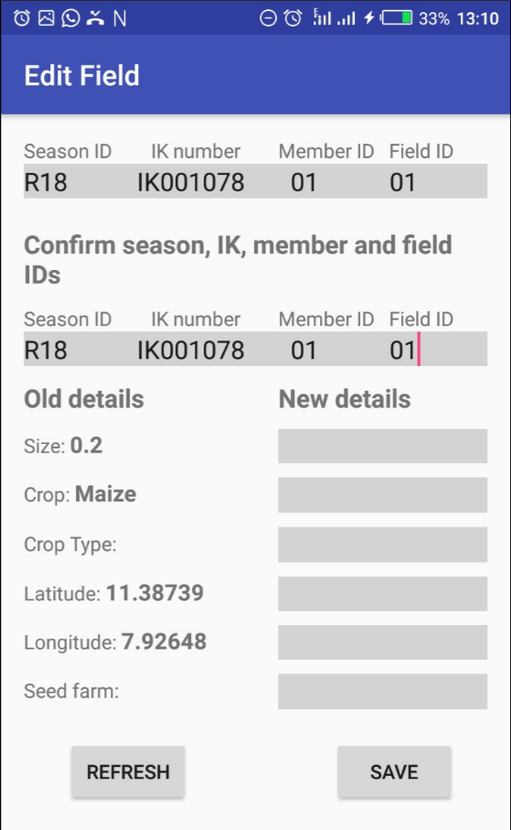
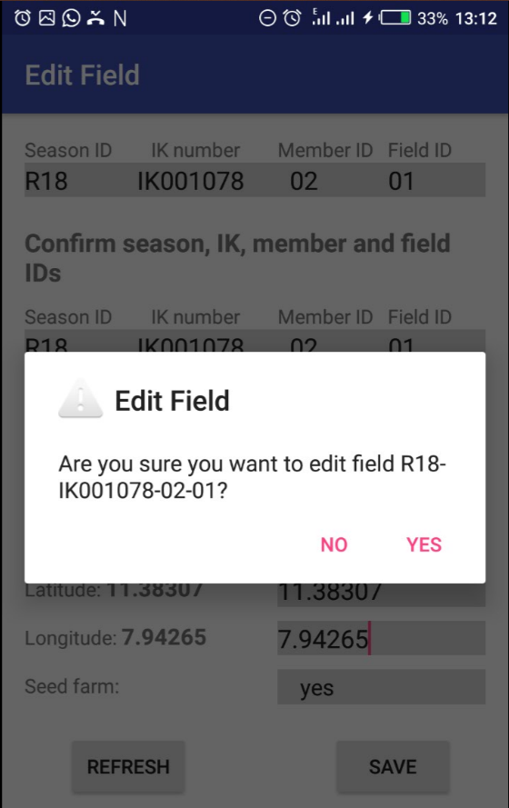
TG Restructuring App
Editing and Deleting fields
For the edit field page, as soon as you enter the IDs of the field, all its details will appear.
If you change the IDs later on, you should refresh the details by clicking the refresh button
After entering the new details, save and confirm. Deleting fields is done similarly

Slide 6
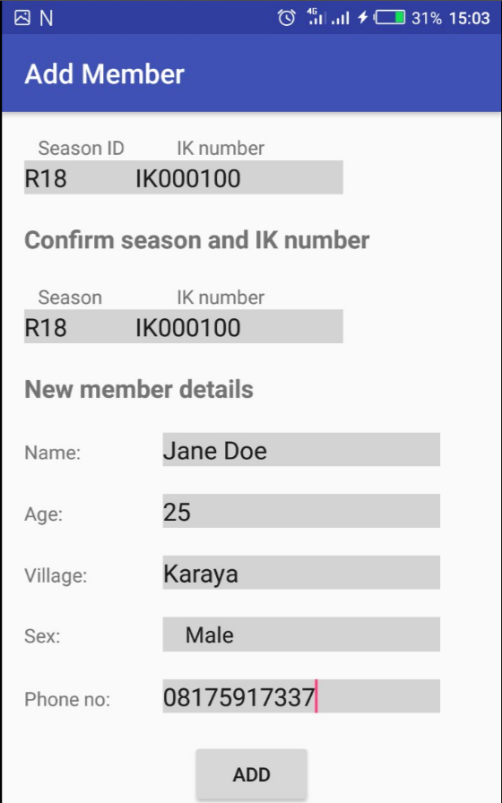
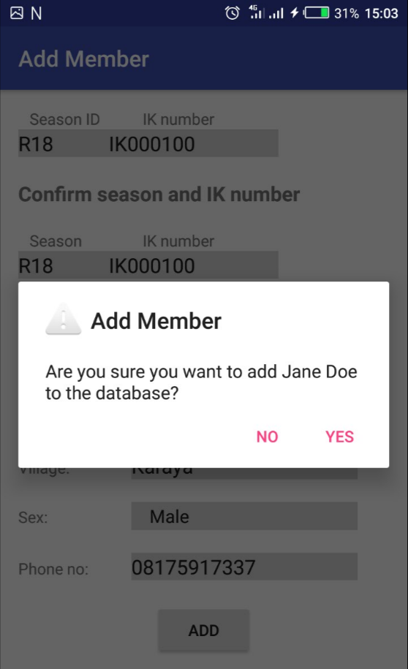
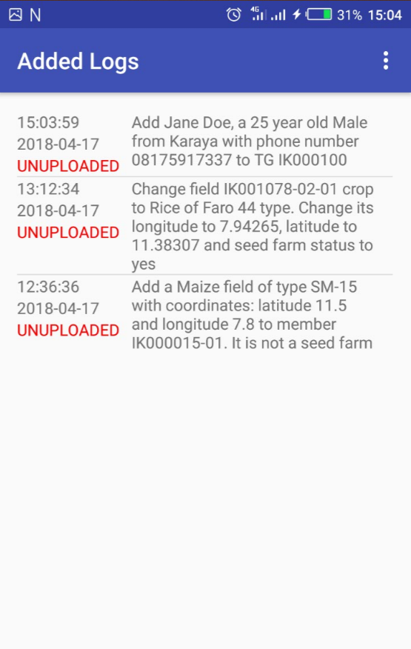
TG Restructuring App
Adding Members
Make sure all fields are complete then click the add button and confirm your addition
If you check the View Logs page, you would see that the log has been added along with the current date and time

Slide 7
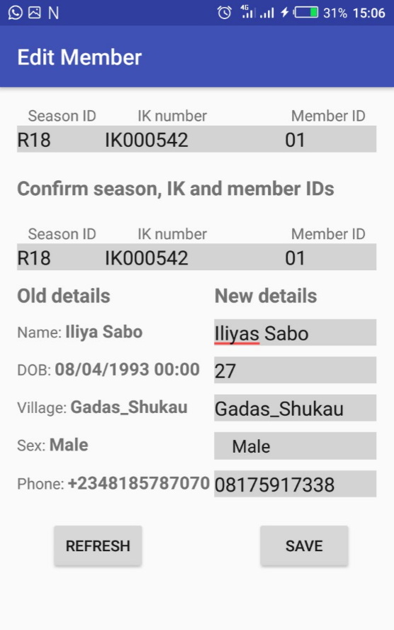
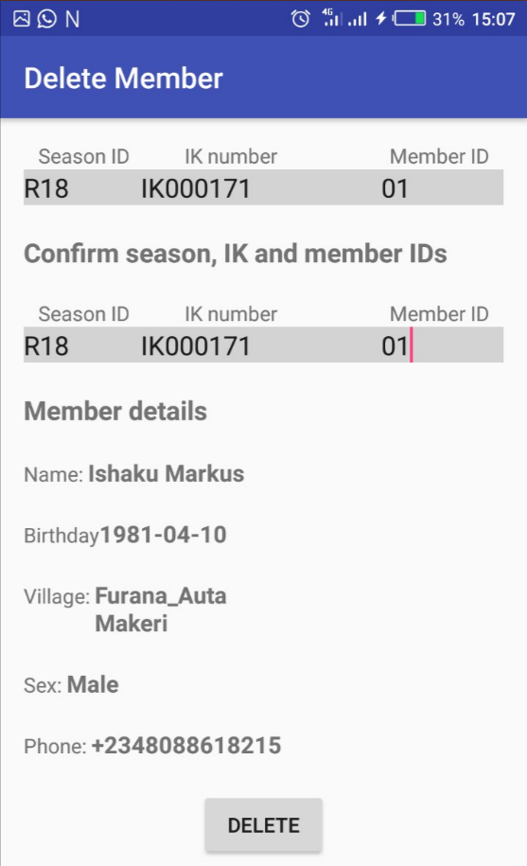
TG Restructuring App
Editing and Deleting members
As with the edit fields page, as soon as you enter the member ID, his/her details appears but be careful to refresh once you make adjustments to the IDs to avoid working with the wrong data. As soon as you are done editing, click on the save button. The same is applicable to the delete members page

Slide 8
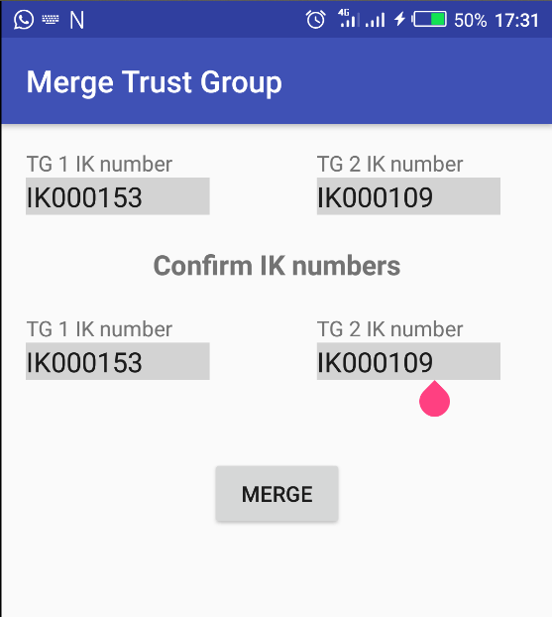
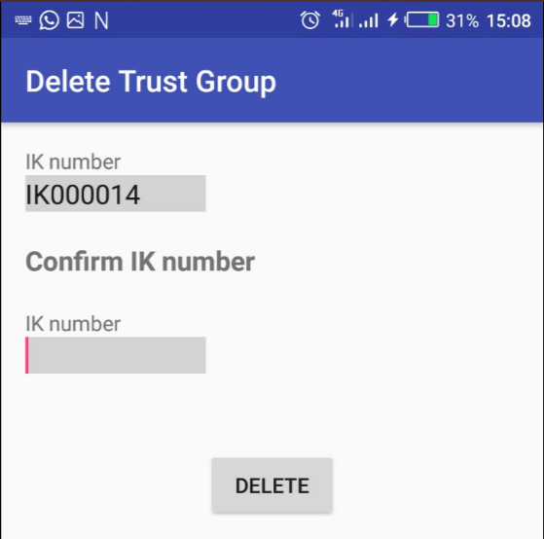
TG Restructuring App
Merging and Deleting TGs
Merging and Deleting TGs is pretty straightforward
To merge two trust groups, just enter and confirm the two IK numbers and click merge
To delete, just enter and confirm the IK number and click delete

Slide 9
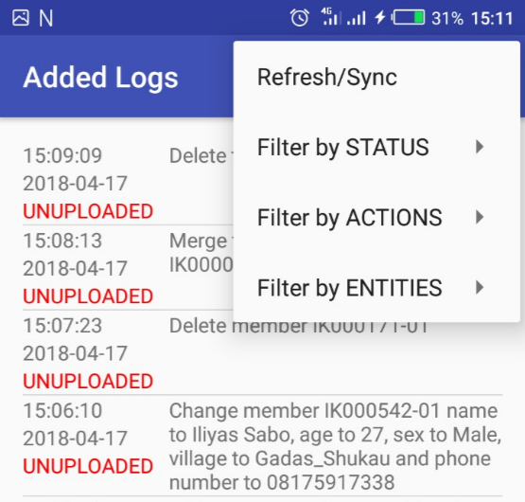
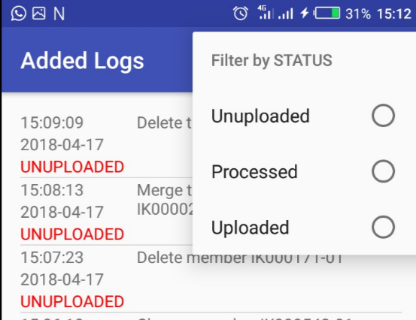
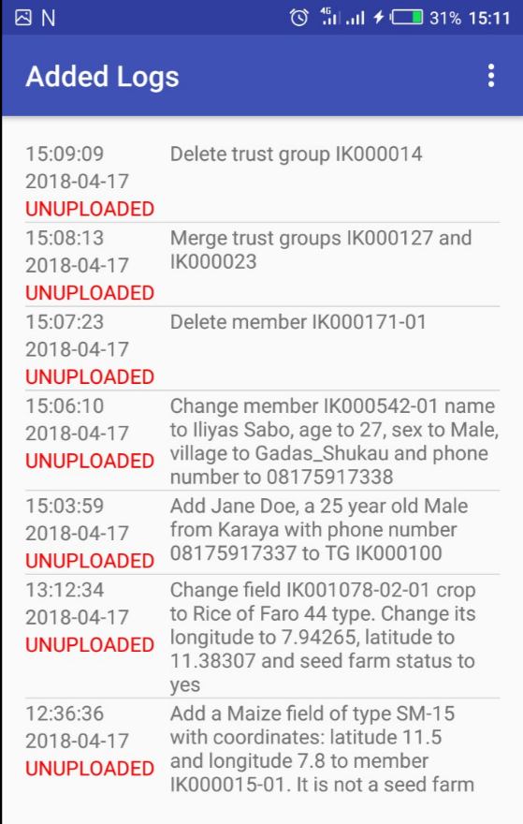

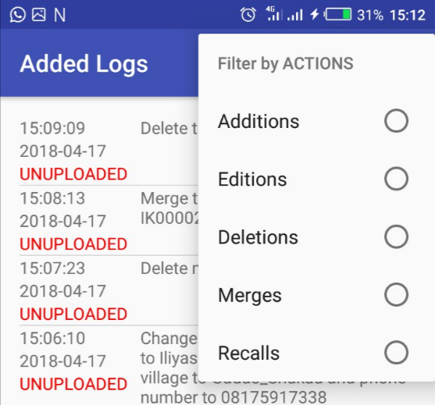
TG Restructuring App
View Logs
On the view Logs page you can view all the logs or a group of the logs by using filters
By clicking refresh/sync if there is an internet connection, the unuploaded logs are uploaded to the online database

Slide 10
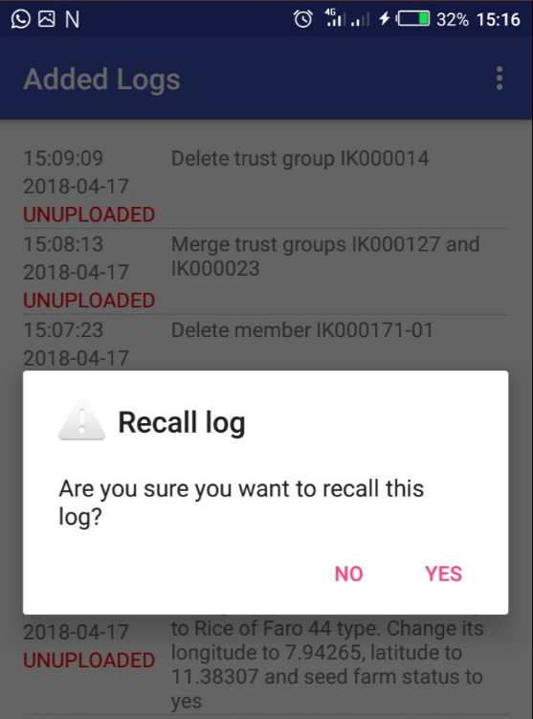
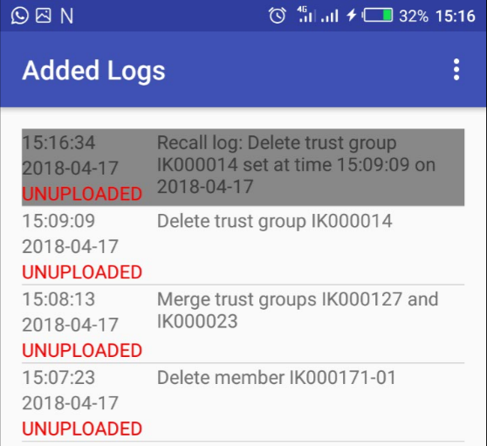
TG Restructuring App
Recalling added logs
You can also recall an added log in case of error. You just need to long press on the log and confirm ‘YES’ on the dialog box to generate the recall log

